Slide 1
Attention bias to disgust in females: The Lexical Decision Task as an implicit measure of sex differences in disgust sensitivity
Zoe Ambrose & Graham C L Davey
University of Sussex, Brighton, UK

Slide 2
Sex Differences in Disgust Sensitivity
Females usually score higher on questionnaire measures of disgust sensitivity
Connolly, Olatunji & Lohr (2007)
Females score higher on measures of both disgust propensity and sensitivity (DPSS-R)
Davey, MacDonald, Kollokho & Davie, unpublished

Slide 3
Disgust & Anxiety Disorders
Higher incidence of anxiety disorders in females than males (Fredrikson et al., 1996; Gullone et al., 2001)
In disgust-relevant disorders this difference may be mediated by sex differences in disgust sensitivity
Blood-injection-injury fear (Olatunji, Arrindell & Lohr, 2005)
Contamination fears (Olatunji, Arrindell, Sawchuk & Lohr, 2005)
Small animal fears (Davey, 1994)

Slide 4
Problems with Inventory Measures
Self-report measures prone to response bias
Sex differences in social acceptability of responses
Need for more direct measures of response biases to disgust stimuli

Slide 5
The Lexical Decision Task
A word information processing task
Reaction times associated with the task reflect the cognitive load required to process the word (Coltheart et al., 1977)
Participants are required to decide whether letter-strings are words or non-words
Participants are usually faster to correctly identify words congruent with their mood (Olafson & Ferraro, 2001)
Task is used extensively in the anxiety and depression literature, but less so in the domain of disgust

Slide 6
Purpose of the Study
Use a Lexical Decision Task to:
Investigate the effect of mood state (disgust v neutral) on processing of disgust words
Investigate the effect of participant’s sex on processing of disgust words
If females process disgust words more quickly than males, this would provide support for the view that sex differences in disgust reflect genuine underlying differences in emotion processing rather than mere social desirability effects

Slide 7
Participants
62 undergraduate and postgraduate students aged 18 to 36 (M= 21.82, SD= 3.80), from the University of Sussex, participated in the experiment.
30 were male, aged 18-36 (M= 22.57, SD= 4.35) and 32 were female, aged 18-32 (M= 21.12. SD= 3.11)
All participants were volunteers who were offered entry into a prize draw as an incentive for taking part.

Slide 8
Design
The experiment employed a 2 (sex: male, female) x 2 (mood induction group: disgust, neutral) x 3 (word type: disgust; neutral; pseudo-word) mixed design.
The between subjects variables were sex and mood induction group and the within subjects factor was word-type.
The dependent variable was reaction time, which had three levels: disgust, neutral and pseudo-word reaction times).

Slide 9
Procedure
HADS & DPSS-R
VAS Mood Measures 1
DISGUST & NEUTRAL mood inductions
VAS Mood Measures 2
Lexical Decision Task
Debriefing & Thanks

Slide 10
Lexical Decision Task
This task consisted of 180 word trials (45 disgust words (eg. vomit), 45 neutral words (eg. video) and 90 filler pseudo-words (eg. movit) which took approximately 7-8 minutes to complete.
13 disgust relevant words were taken from Charash (2002) and 32 more were created from these, using a thesaurus.
Disgust words were matched with neutral words of a similar written word frequency, word type (eg. noun, verb, adjective) and number of letters, using Kucera & Francis (1982).
Pseudo-words; letter strings which follow the same grammatical structure as real words but are not actual words were created by using anagrams of the disgust and neutral words.
Stimuli were presented one at a time, in the centre of the screen, in size 22 Courier New font, in a sequential order, with a 450 millisecond inter-trial interval between each word trial. Participants were required to press ‘1’ if the stimulus was a word or ‘0’ if the stimulus was a non-word.

Slide 11
Results: Mood Inductions
Participants in the DISGUST mood group reported greater disgust (M= 49.50, SE=4.40) post mood induction than participants in the NEUTRAL group (M=4.70, SE=1.35). This difference was significant [t(36.76) = 9.73, p<.001].
However, post mood-induction, DISGUST mood group showed higher levels of anxiety and lower levels of happiness than NEUTRAL mood group

Slide 12
Comparability of Groups
No significant differences between the two mood groups prior to the experiment on measures of DPSS-R disgust propensity; [t(60)= .89 p=.38], DPSS-R disgust sensitivity; [t(60)=.90 p=.37], HADS anxiety [t(60) = -.09 p=.93] or HADS depression. [t(60)= -.89 p=.38]
Greater disgust propensity was reported in females (M= 24.00 SE= .67) than males, (M=22.07 SE=.61) [t(60)=-2.13 p<.05.].
Greater disgust sensitivity was also reported in females (M= 20.41 SE=.87) than males (M= 16.13 SE= .67) [t(60)=-3.85 p<.001.]

Slide 13
Reaction Time Data
Significant main effect for word type [F(2,116)= 56.49 p<.001.]. Participants responded significantly slower to pseudo-words than to disgust words, and to neutral words; but reaction time did not differ significantly between disgust words and neutral words.
No significant interaction was found between word type and mood condition [F(2,116) = .78 p>.05] or between word type, group and sex, [F(2,116) = .69 p>.05].
There was a significant interaction between word type and sex. F(2,116) = 3.23 p<.05, in which females exhibited faster reaction times to disgust words than males.

Slide 14
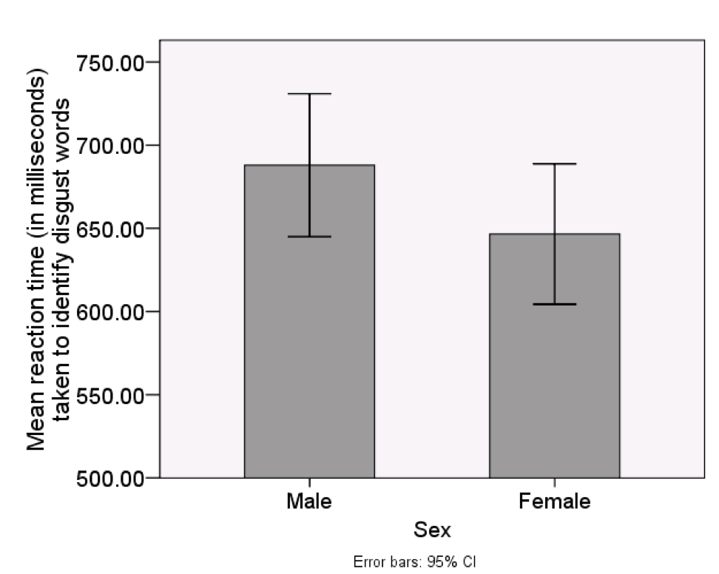
Reaction Time: Disgust Words

Slide 15
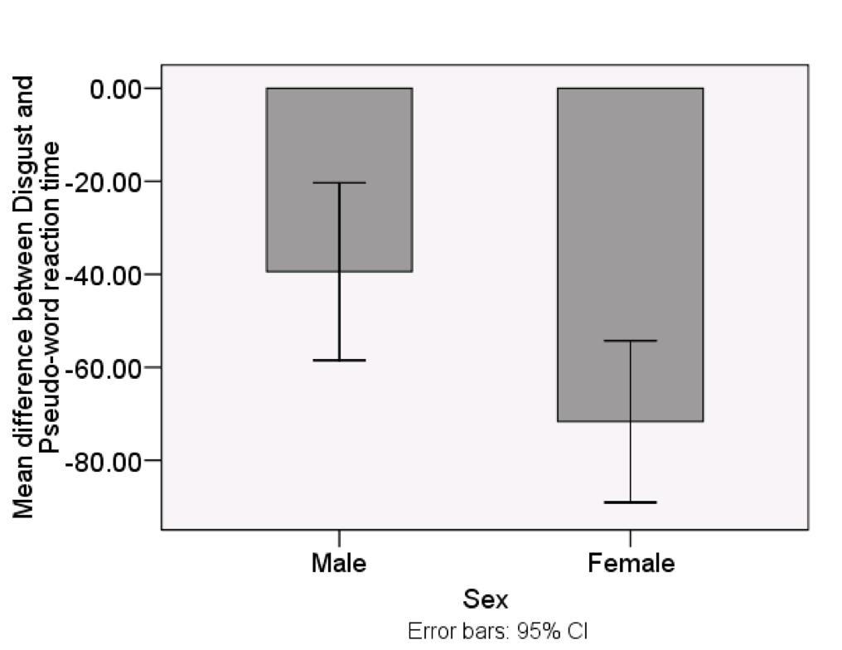
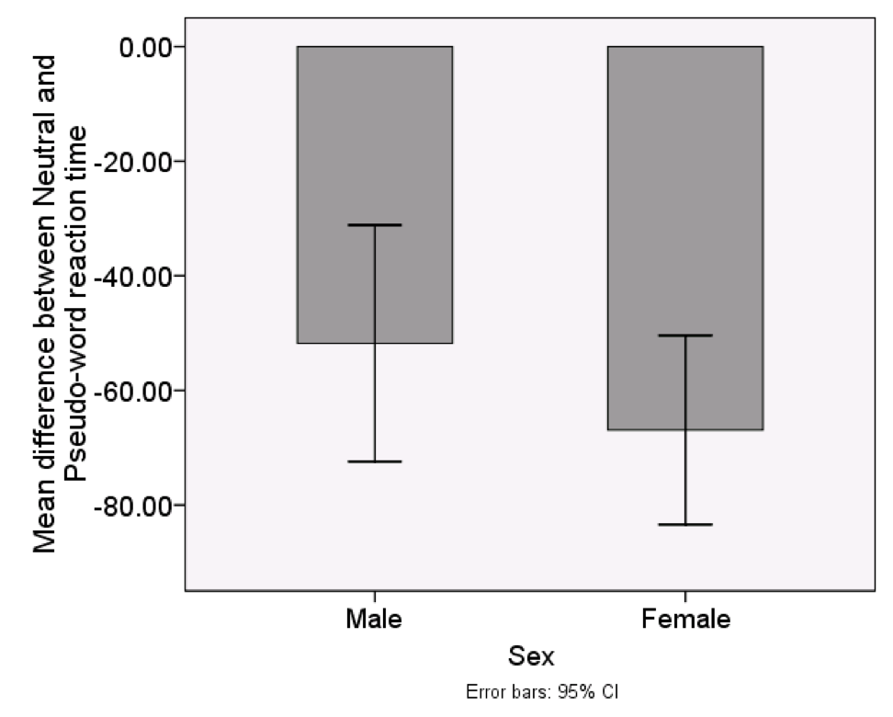
Difference Score Analysis

Slide 16
Conclusions
Females respond significantly faster than males to disgust words
Females scored significantly higher than males on DPSS-R Propensity & Sensitivity
No differences in error rates between males and females
No differential effect of mood state on processing of disgust words
Results suggest that sex difference in disgust sensitivity exists at the level of processing disgust-relevant stimuli
Findings may reflect stronger mental representations of disgust or more refined categorization of disgust in females than males
Further research needed to determine whether this sex difference in processing contributes to sex differences in vulnerability to disgust-relevant anxiety disorders

